Slide 1
A New Model for Coalescent with Recombination
Zhi-Ming Ma
ECM2013 PolyU
Email: mazm@amt.ac.cn
http://www.amt.ac.cn/member/mazhiming/index.html

Slide 2
The talk is base on our recent two joint papers:
A New Method for Coalescent Processes with Recombination
Ying Wang¹, Ying Zhou², Linfeng Li³, Xian Chen¹, Yuting Liu³, Zhi-Ming Ma^{1,}*, Shuhua Xu^{2,}*
Markov Jump Processes in Modeling Coalescent with Recombination
Xian Chen¹, Zhi-Ming Ma¹, Ying Wang¹
¹: Academy of Math and Systems Science, CAS
²: CAS-MPG Partner Institute for Computational Biology
³: Beijing Jiaotong University,

Slide 3
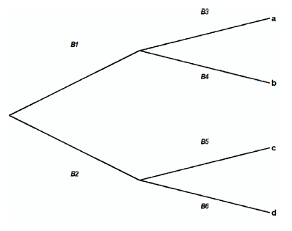
Background:
Molecular evolution and phylogenetic tree
a ATCCTAGCTAGACTGGA
b GTCCTAGCTAGACGTGA
c ATCCCAGCTAGACTGCA
d ATCCTAGCTAGACGGGA

Slide 4
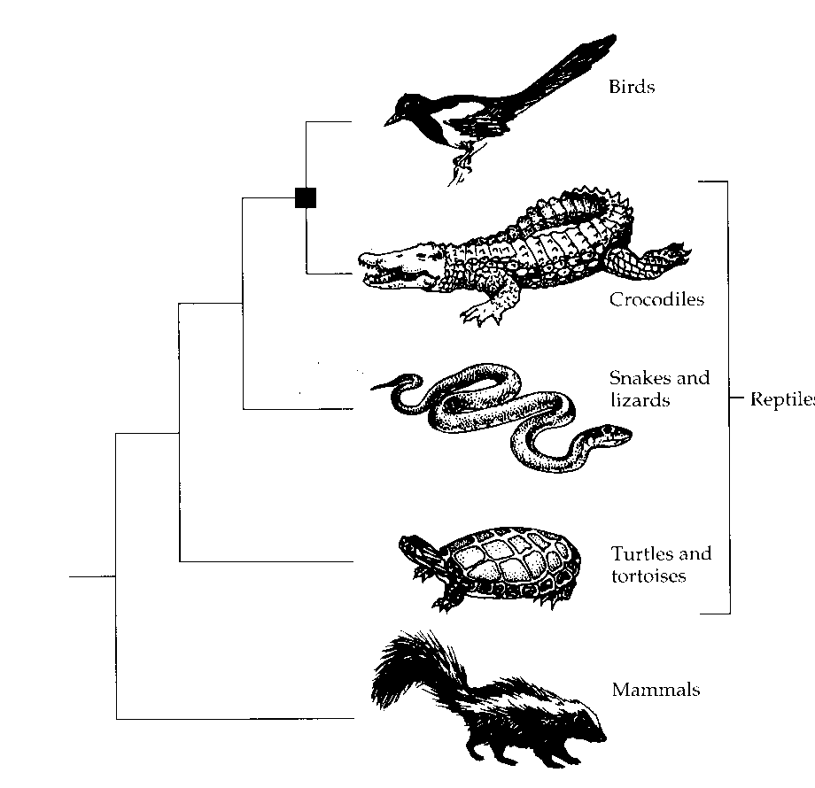
A real coalescent tree
鸟类
鳄鱼
爬行动物
蛇和蜥蜴
海龟和陆龟
哺乳动物
Molecular Evolution - Li

Slide 5

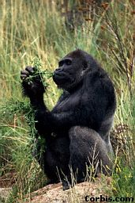
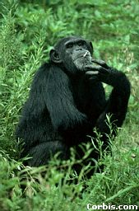
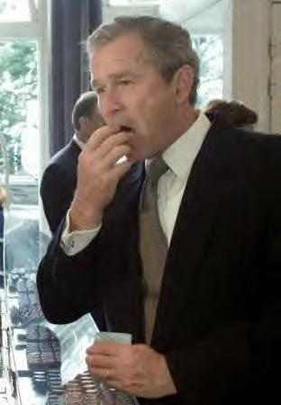
Phylogenetic trees are about visualising evolutionary relationships
From the Tree of the Life Website,
University of Arizona
猩猩Orangutan
大猩猩Gorilla
黑猩猩Chimpanzee
人类Humanity
Notes:
A phylogeny is a tree representation for the evolutionary history relating the species we are interested in.
This is an example of a 13-species phylogeny.
At each leaf of the tree is a species – we also call it a taxon in phylogenetics (plural form is taxa). They are all distinct.
Each internal node corresponds to a speciation event in the past.
When reconstructing the phylogeny we compare the characteristics of the taxa, such as their appearance, physiological features, or the composition of the genetic material.

Slide 6
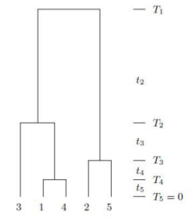
Simulation:
Coalescent without Recombination
  Trace the ancestry of the samples
  Markov jump process --Coalescent Process (Kingmann 1982)
A realization for sample of size 5

Slide 7
What is recombination?
Germ cells
Recombination is a process by which a molecule of nucleic acid (usually DNA, but can also be RNA) is broken and then joined to a different one.
Chromosome breaks up
gamete 1
gamete 2

Slide 8
Why study recombination?
An important mechanism generating and maintaining diversity
One of the main sources to provide new genetic material to let nature selection carry on
Mutation
Selection
Recombination

Slide 9
Application of recombination information
DNA sequencing
  Identify the alleles that are co-located on the same chromosome
Disease study
  Estimate disease risk for each region of genome
Population history study
  Discover admixture history
  Reconstruct human phylogeny

Slide 10

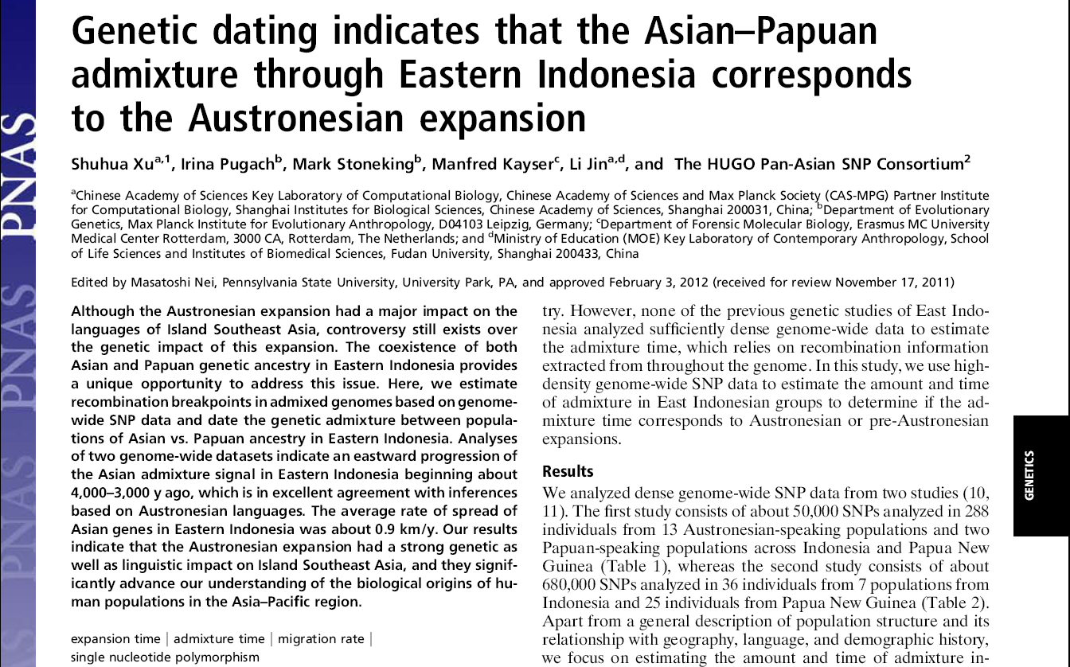
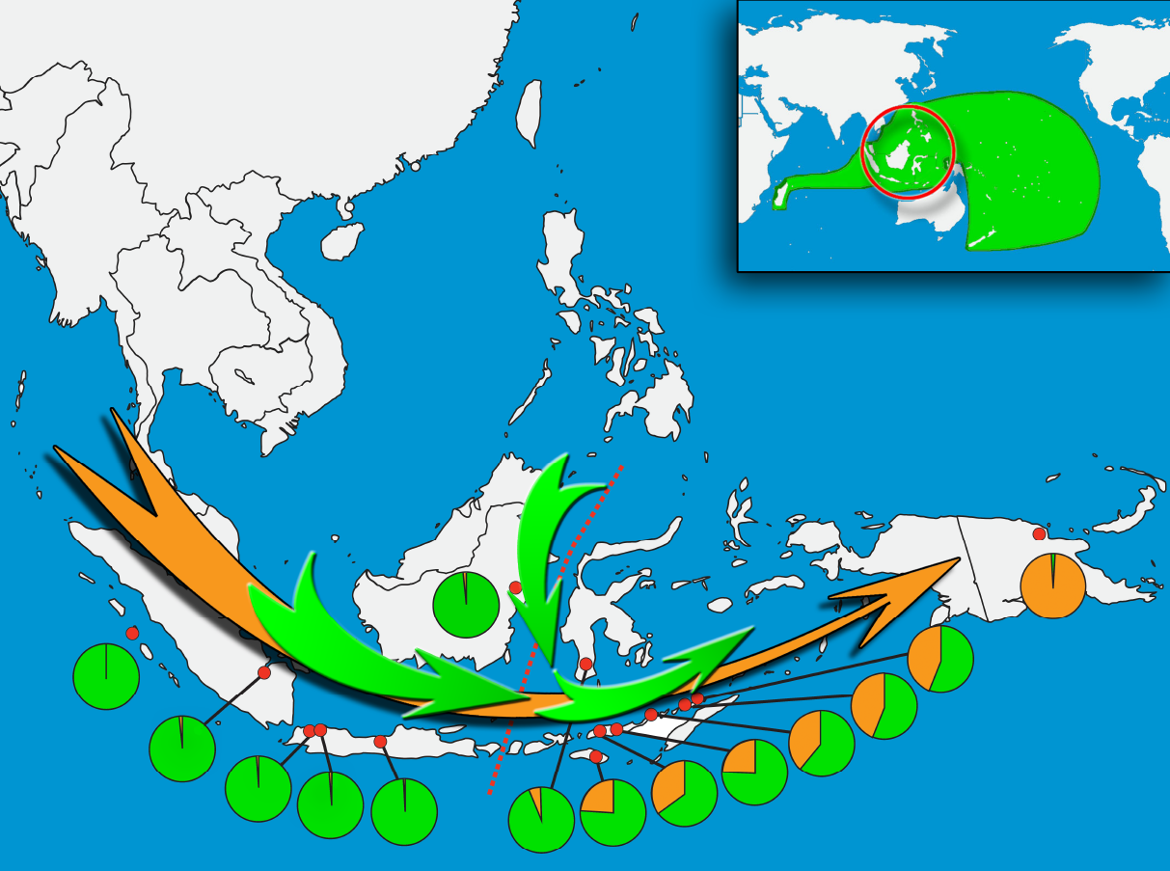
Dating Admixture and Migration Based on Recombination Info
First Genetic Evidence

Slide 11
Statistical Inference of Recombination
The phenomenon of recombination is extremely complex.
Simulation methods are
indispensable in the statistical inference of recombination.
--can be applied to exploratory data analysis. Samples simulated under various models can be combined with data to test hypotheses.
-- can be used to estimate recombination rate.

Slide 12
Basic model assumption
Wright-fisher model with recombination
  The population has constant size N,
  With probability 1-r, uniformly choose one parent to copy from (no recombination happens), with probability r, two parents are chosen uniformly at random, and a breakpoint s is chosen by a specified density (recombination event happens ).
  Continuous model is obtained by letting N tends to infinity. Time is measured in units of 2N, and the recombination rate per gene per generation r is scaled by 2rN=constant. The limit model is a continuous time Markov jump process .

Slide 13
Model the sequence data
Without recombination
  Sequence can be regarded as a point
With recombination
  Sequence should be regarded as a vector or an interval

Slide 14
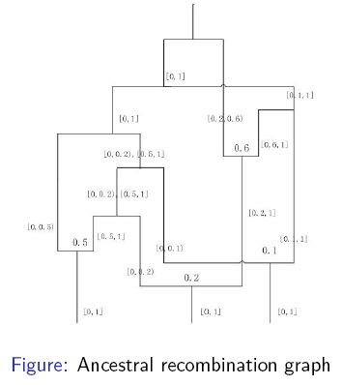
Two classes simulation models
  Back in time model
  First proposed (Hudson 1983)
  Ancestry recombination graph (ARG)
  (Griffiths R.C., Marjoram P. 1997)
  Software: ms (Hudson 2002)
  Spatial model along sequences
  Point process along the sequence
  (Wuif C., Hein J. 1999)
  Approximations: SMC(2005)、
  SMC’(2006)、MaCS(2009)
Resulting structure: ARG

Slide 15
Back in time model
Merit
Due to the Markov property, it is computationally straightforward and simple
Disadvantage
It is hard to make approximation, hence it is not suitable for large recombination rate

Slide 16
Spatial model along sequences
Merits
- the spatial moving program is easier to approximate
- approximations: SMC(2005)、SMC’(2006)、 MaCS(2009)
Disadvantages
- it will produce redundant branches
- complex non-Markovian structure
- the mathematical formulation is cumbersome and up to date no rigorous mathematical formulation

Slide 17
Our model: SC algorithm
SC is also a spatial algorithm
SC does not produce any redundant branches which are inevitable in Wuif and Hein’s algorithm.
Existing approximation algorithm (SMC, SMC’, MaCS) are all special cases of our model.

Slide 18
Rigorous Argument
We prove rigorously for the first time that the statistical properties of the ARG generated by our spatial moving model and that generated by a back in time model are the same: they share the same probability distribution on the space of ARG
Provides a unified interpretation for the algorithms of simulating coalescent with recombination.

Slide 19

Mathematical models
Markov jump process behind back in time model
- state space
- existence of Markov jump process
- sample paths concentrated on G
Point process corresponding to the spatial model
- construct on G
- projection of q-processes
- distribution of
Identify the probability distribution

Slide 20
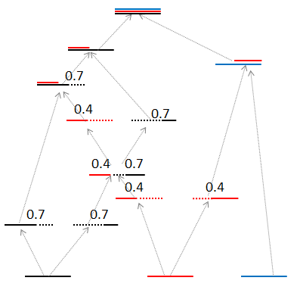
Back in time model
Starts at the present and performs backward in time generating successive waiting times together with recombination and coalescent events until GMRCA (Grand Most
Recent Common Ancestor)

Slide 21
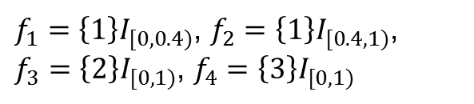

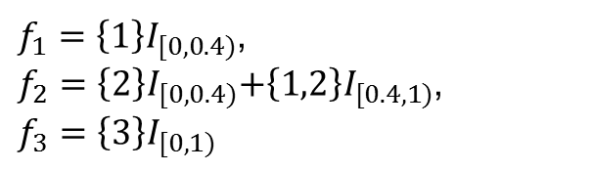
State space of the process
0.4
$f_{1}=\left\{1\right\}I_{[0,0.4)}$, $f_{2}=\left\{2\right\}I_{[0,0.4)}\text{+}\left\{1,2\right\}I_{[0.4,1)}$, $f_{3}=\left\{3\right\}I_{[0,1)}$
0.4
0.4
$f_{1}=\left\{1\right\}I_{[0,0.4)}$, $f_{2}=\left\{1\right\}I_{[0.4,1)}$, $f_{3}=\left\{2\right\}I_{[0,1)}$, $f_{4}=\left\{3\right\}I_{[0,1)}$
$f_{1}=\left\{1\right\}I_{[0,1)}$, $f_{2}=\left\{2\right\}I_{[0,1)}$, $f_{3}=\left\{3\right\}I_{[0,1)}$

Slide 22
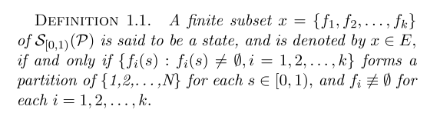

State space of the process
Let $P$ be the collection of all the subsets of $\left\{1,2,…,N\right\}$.
$S_{\left[0,1\right)}(P)$ be all the $P$-valued right continuous piecewise constant functions on $\left[0,1\right)$ with at most finite many discontinuous points.
$f∈S_{\left[0,1\right)}(P)$ can be expressed as $f=\sum_{j=0}^{m}{f\left(a_{j}\right)I_{[a_{j, }a_{j+1})}}$ with $0=a_{0}<a_{1}<⋯<a_{m}<a_{m+1}=1$

Slide 23
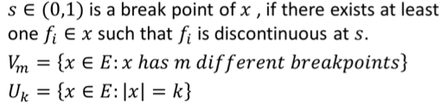
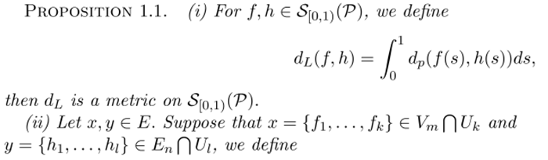

Introduce suitable metric on E

Slide 24
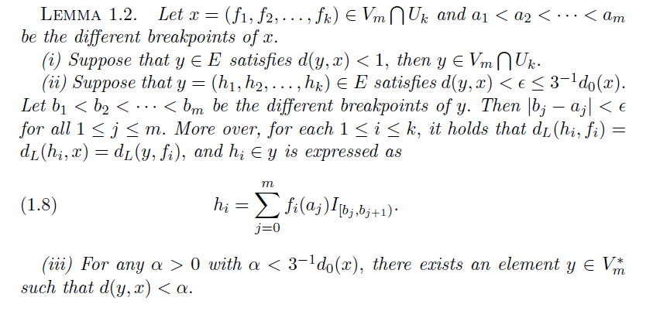
E is a locally compact separable metric space

Slide 25
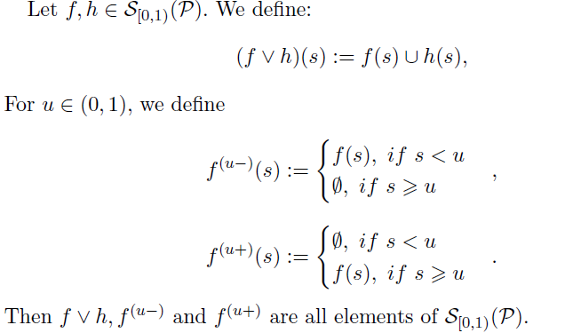
Introduce suitable operators on E
coalescence
recombination

Slide 26
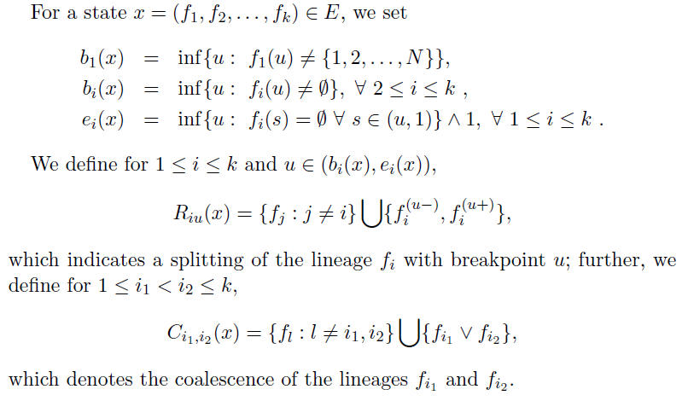
Introduce suitable operators on E
avoiding
redundant
recombination
coalescence

Slide 27
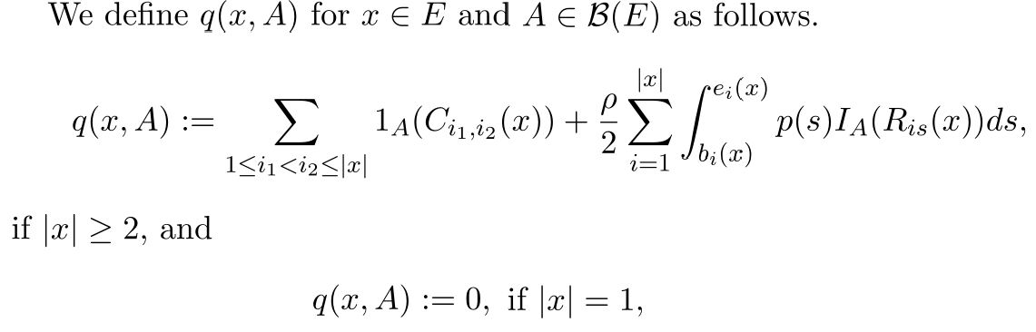

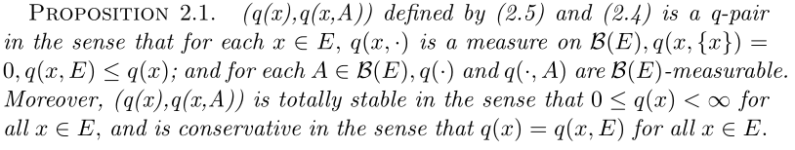

Existence of the Markov Jump Process
Define further
Key point: prove that

Slide 28
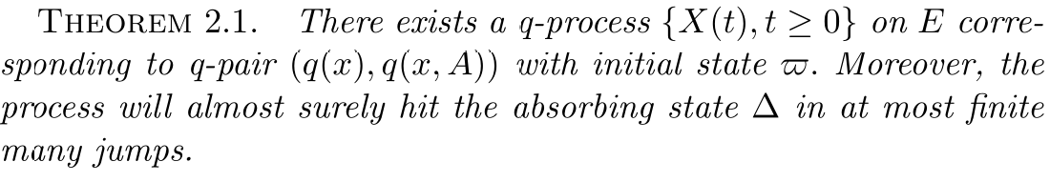

Existence of the q-process
Intuitively the q-process will arrive at the absorbing state in at most finite many jumps.
A rigorous proof needs order-preserving coupling

Slide 29




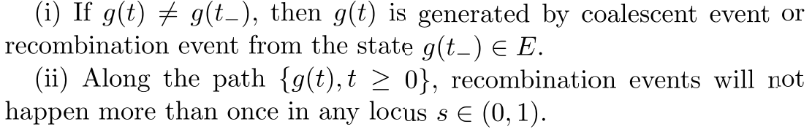
ARG Space G
: all the E-valued right continuous
piecewise constant functions with at
most finite many discontinuity points.
if it satisfies:

Slide 30


ARG Space G

Slide 31
Spatial Model along Sequences
Spatial model begins with a coalescent tree at
the left end of the sequence.
Adds more different local trees gradually along the sequence, which form part of the ARG.
The algorithm terminates at the right end of the sequence when the full ARG is determined.

Slide 32
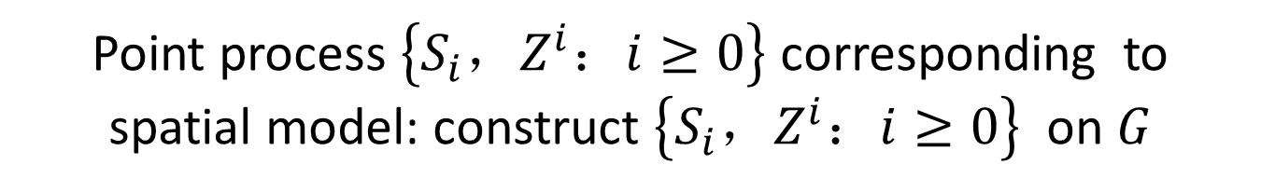
Point process $\left\{S_{i}，Z^{i}：i≥0\right\}$ corresponding to spatial model: construct $\left\{S_{i}，Z^{i}：i≥0\right\}$ on $G$
0.7
0.4
0.7
0.4
0.7
0.4
0.4
0.7
0.7

Slide 33
Point process $\left\{S_{i}，Z^{i}：i≥0\right\}$ corresponding to spatial model: construct $\left\{S_{i}，Z^{i}：i≥0\right\}$ on $G$
0.7
0.4
0.7
0.4
0.7
0.4
0.4
0.4
0.7
0.7

Slide 34
Point process $\left\{S_{i}，Z^{i}：i≥0\right\}$ corresponding to spatial model: construct $\left\{S_{i}，Z^{i}：i≥0\right\}$ on $G$
0.7
0.4
0.7
0.4
0.7
0.4
0.4
0.7
0.7
0.7
0.4

Slide 35
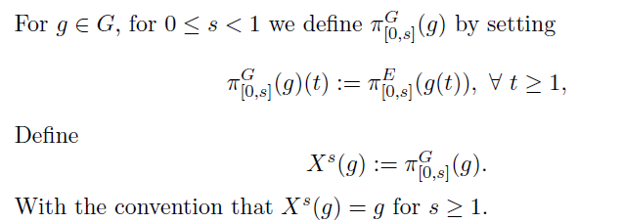


Projection of q-processes
a Markov jump process ?

Slide 36
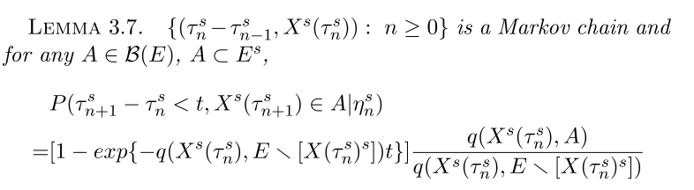

Projection of q-processes
is a time homogenous
Markov jump process !

Slide 37

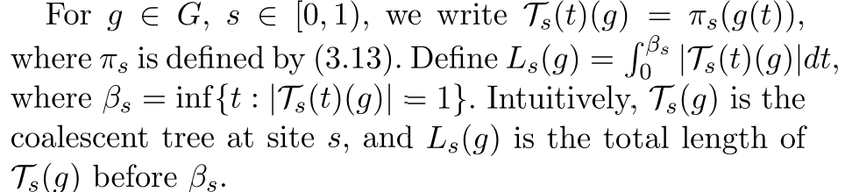
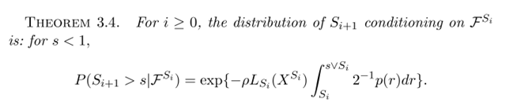
Waiting time is exponentially distributed with parameter
depends on the total length of the current local tree

Slide 38
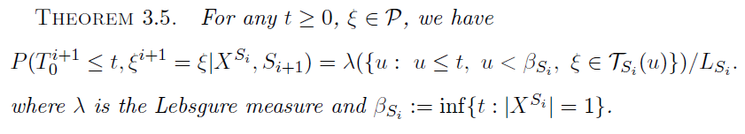


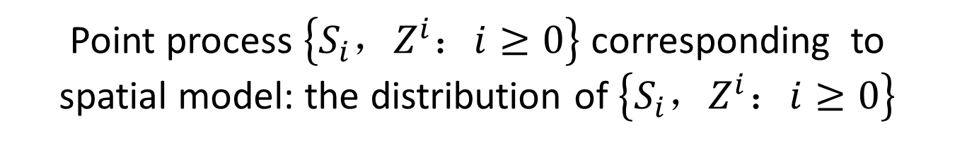
Point process $\left\{S_{i}，Z^{i}：i≥0\right\}$ corresponding to spatial model: the distribution of $\left\{S_{i}，Z^{i}：i≥0\right\}$
The position of on the current local tree
is uniformly distributed on the local tree

Slide 39
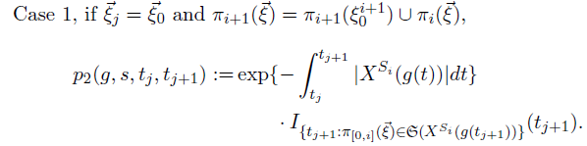
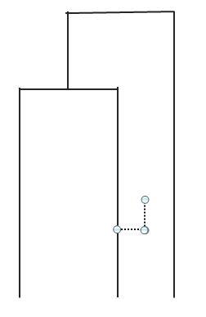
Point process $\left\{S_{i}，Z^{i}：i≥0\right\}$ corresponding to spatial model: the distribution of $\left\{S_{i}，Z^{i}：i≥0\right\}$
It will coalesce to any existing branches independently with rate 1.

Slide 40
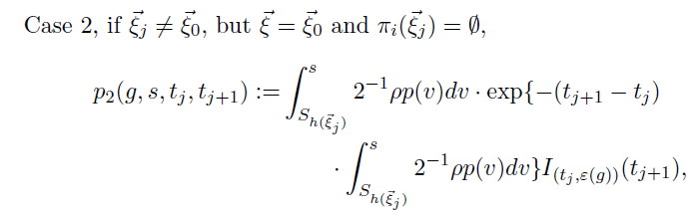

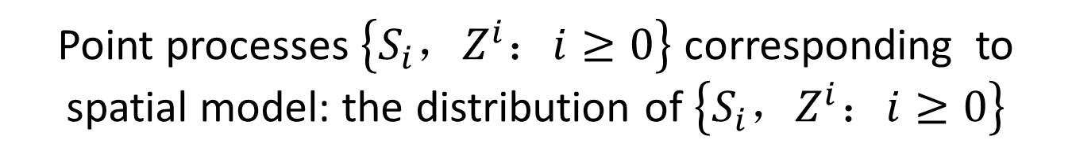
Point processes $\left\{S_{i}，Z^{i}：i≥0\right\}$ corresponding to spatial model: the distribution of $\left\{S_{i}，Z^{i}：i≥0\right\}$
If it coalescent to an old branch, it will move along the old branch and leave it with rate

Slide 41
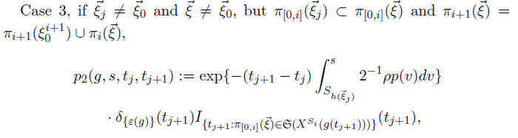

Point process $\left\{S_{i}，Z^{i}：i≥0\right\}$ corresponding to spatial model: the distribution of $\left\{S_{i}，Z^{i}：i≥0\right\}$
If it does not leave the old branch ,
It will move along to the next branch

Slide 42
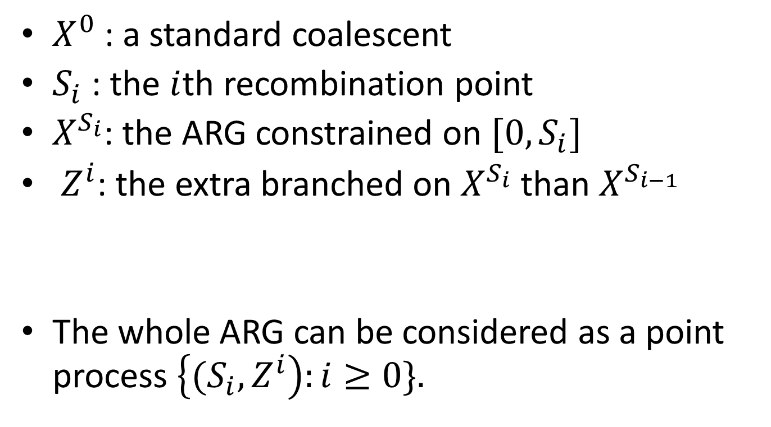
SC algorithm
$X^{0}$ : a standard coalescent
$S_{i}$ : the $i$th recombination point
$X^{S_{i}}$: the ARG constrained on ${[0,S}_{i}]$
$Z^{i}$: the extra branched on $X^{S_{i}}$ than $X^{S_{i−1}}$
The whole ARG can be considered as a point process $\left\{{(S}_{i},Z^{i}\right):i≥0\}.$

Slide 43
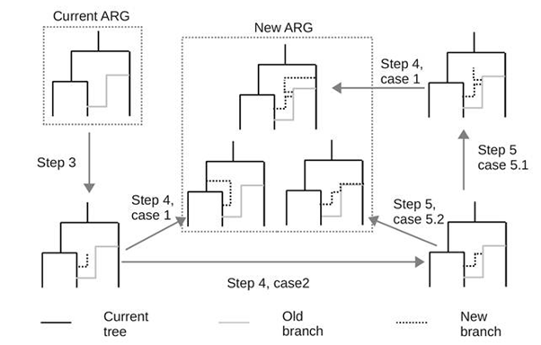

Slide 44
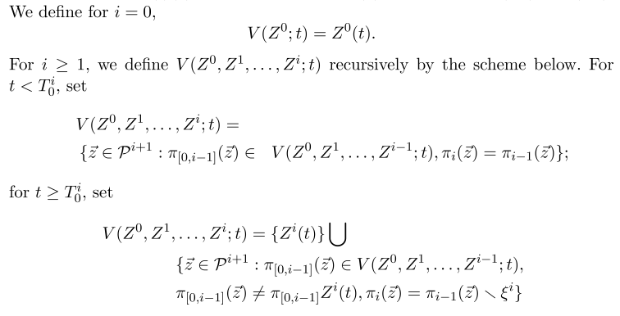
Identical probability distribution of the back in time model and spatial model

Slide 45
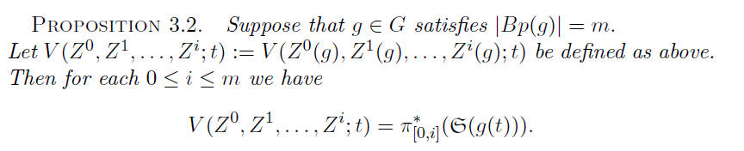


Identical probability distribution of the back in time model and spatial model

Slide 46
Summary
we developed a new alrorighm for modeling coalescence with recombination
The new algorithm does not produce any redundant branches which are inevitable in previous methods
The existing approximation algorithms are all special cases of our model.

Slide 47
Summary
We prove rigorously for the first time that the statistical properties of the ARG generated by our spatial moving model and that generated by a back in time model are the same: they share the same probability distribution on the space of ARG
Provides a unified interpretation for the algorithms of simulating coalescent with recombination.

Slide 48
Thank you !

